Slide 1

Presidential Briefing on Marijuana
Jena Koetz
Michelle Nassau

Slide 2
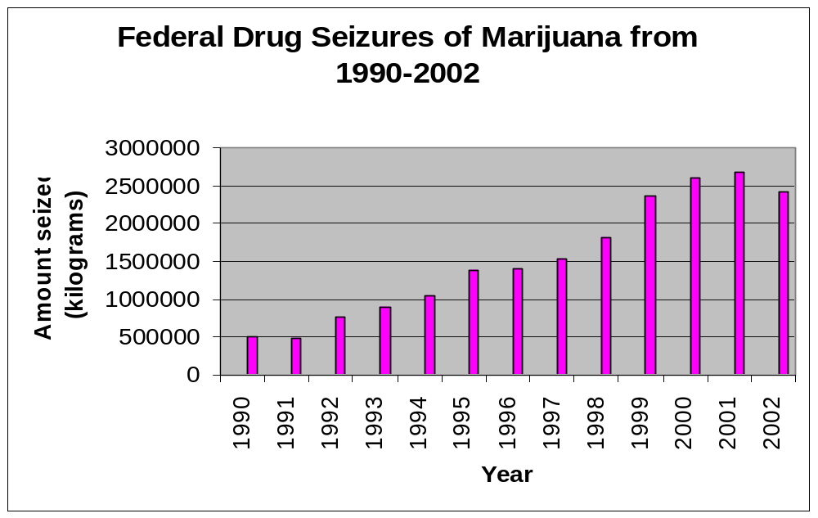
Marijuana Seizures 1990-2002
-Overall marijuana seizures increased steadily until 2001
-Absolute min: 514,723 kg (1990)
Absolute max: 2,677,613 kg (2001)
-Seizures in 2002 are approx. 5 times greater than those of 1990
-Decrease from 2001 to 2002 may be in part due to Sept. 11th
No. 304. Source: US Drug Enforcement Administration, unpublished data from federal-wide Drug Seizure Systems

Slide 3
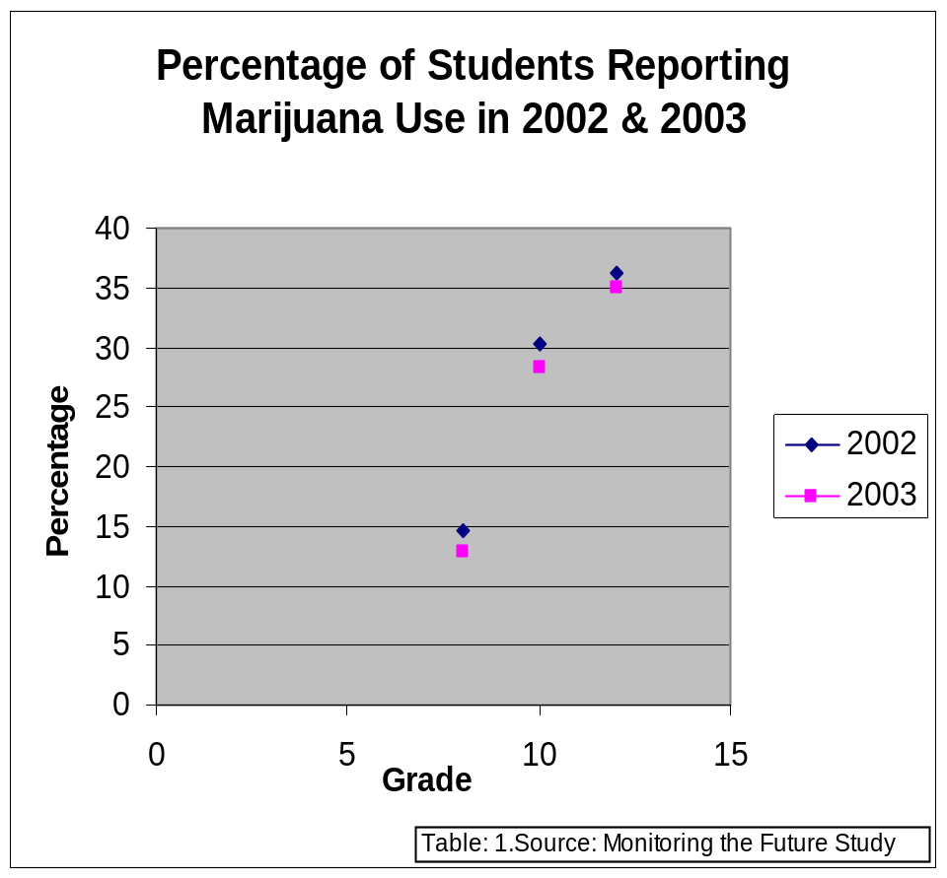
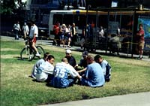
Students and Marijuana
-Grades: 8, 10, 12
-Percent Change 2002-2003: (8th Grade) 12% decrease, (10th Grade) 7% decrease, (12th Grade) 4% decrease
Percent Change decreasing each year possibly due to less students reporting

Slide 4
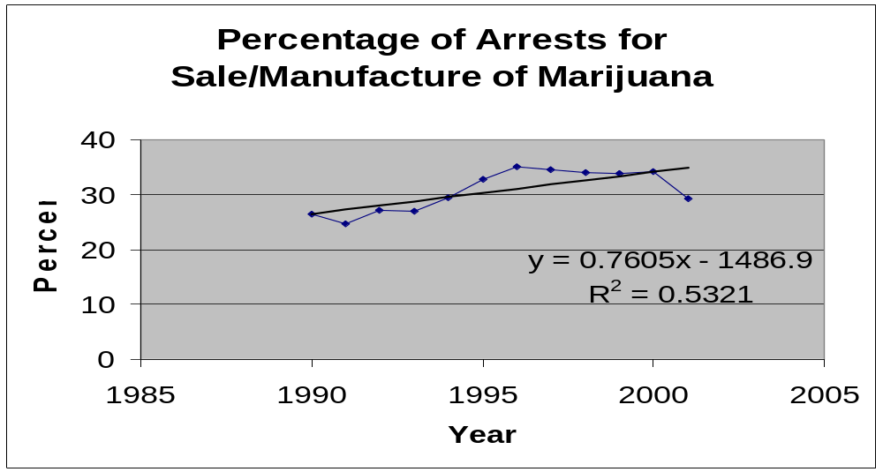

Arrests
No. 303. Source: US Federal Bureau of Investigation, Crime in the US, Annual.
-Gradual increase from 1990-2000
-Decline from 2000-2001, maybe due to Sept. 11 attacks
-less focus on drug related arrests
-Percent Change 1990-2001: 11% ((29.3-26.4)/26.4)
2000-2001: 14% decline ((29.3-34.2)/34.2)
-Significant because it changed more over this one year period than over 10 years

Slide 5
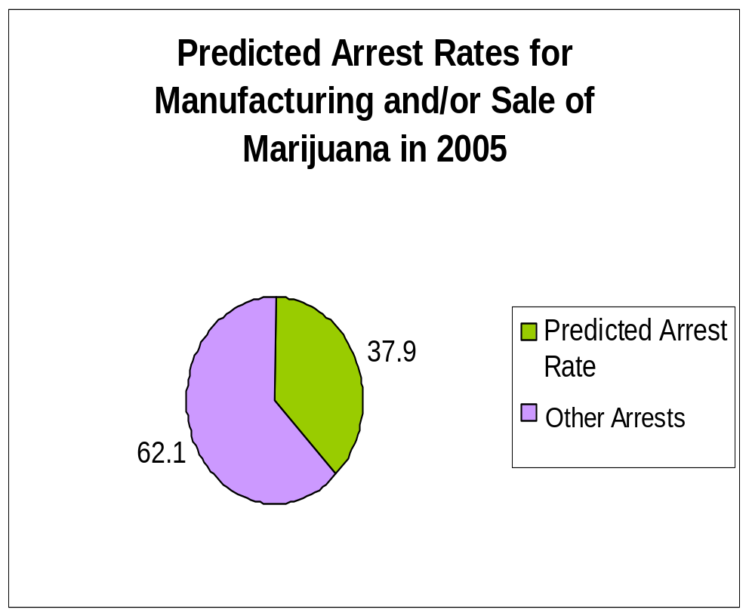
Prediction for 2005
-Using the equation: y=0.7605x-1486.9 we predict that the percent of arrests will be 37.9% in the year 2005
-62.1% for other drug related offenses
-Because R^2=0.5321, less faith placed in prediction
-Not a lot of confidence in prediction because it appears that the data points are heading away from line

Slide 6

Overview
Seizures and arrests both decreased from 2001-2001
Percentage of students reporting marijuana use also decreased from 2002-2003
Contrary to prediction we feel that arrest rates may actually decrease by 2005
September 11th may be a contributing factor to these declines because of increased focus on security

